Slide 1

Student: Milton Puentes
teacher: Diana Escobar
curse:10-01

Slide 2

DESCRIPTION
The Mitsubishi Lancer Evolution is a sport all-wheel-drive saloon that has a supercharged 295 hp engine. It is the most powerful version of the Lancer range

Slide 3
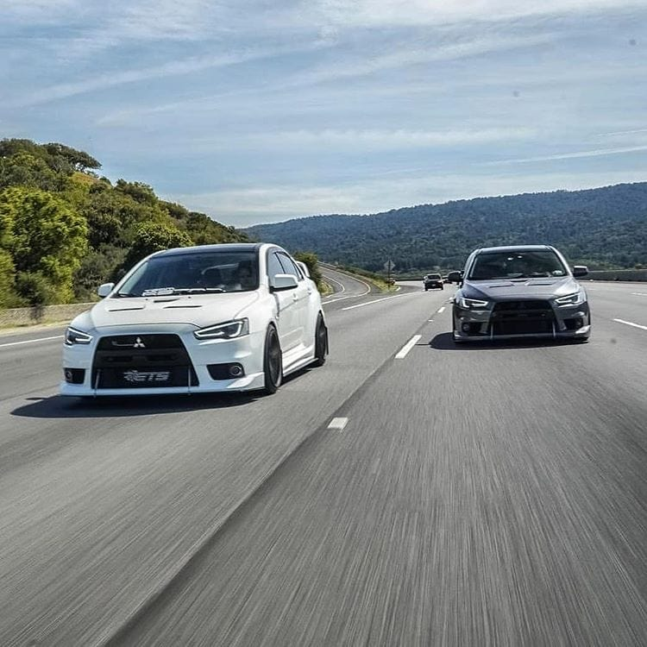
ENGINE
The engine of the Mitsubishi Lancer Evolution X, called 4B11, in order to squeeze thoroughly that MIVEC 2.0 turbo 300 horsepower.

Slide 4

ACTUAL PRICE
the current price of this automobile is 180,000,000 million colombian pesos

Slide 5
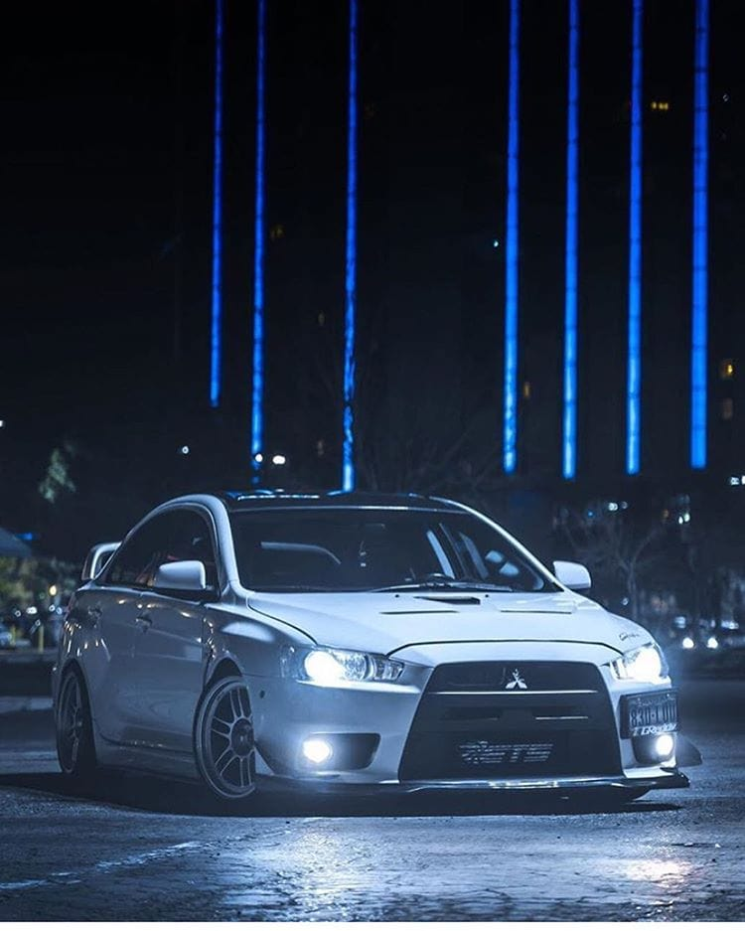
THANK YOU

