Slide 1
Candy Angeles Camp
presented by:
presented by:
Presented by: Milton Puentes,David Babativa y Angie cuesta
Presented to :Diana Escobar .
1001

Slide 2
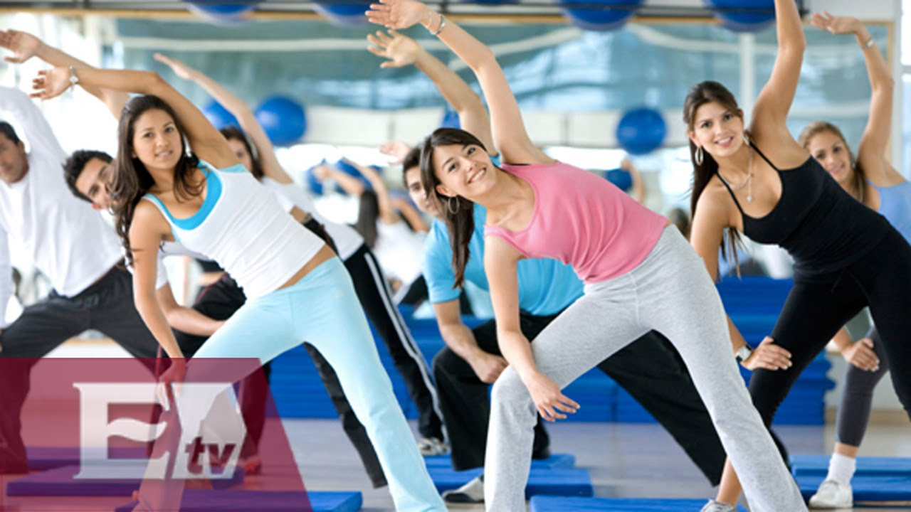
What activities are there?
1 day
Morning:
Group Breakfast Aerobic exercise centers after that there will be recreational and cognitive activities

Slide 3
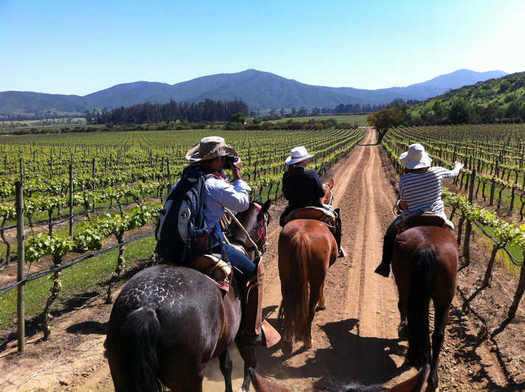
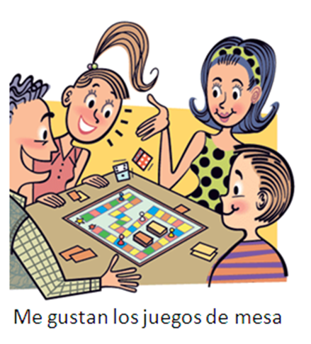
Afternoon: Lunch go to Horseback Riding
night: board games

Slide 4
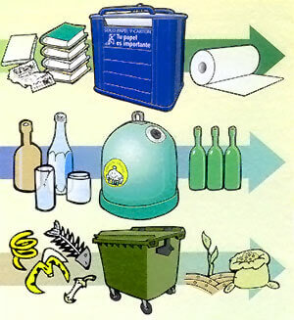
2 Day
Breakfast after breakfast they go to the forest to do cleaning from 8 to 12 and from 2 to 6 cleaning the river
at night they leave

Slide 5
What team does the people need?
change clothes
blocker
glasses
Lanterns
Sleeping bag
suitcase
swimwear food

