Slide 1


COLEGIO CLASS I.E.D
Do you eat well?

Slide 2
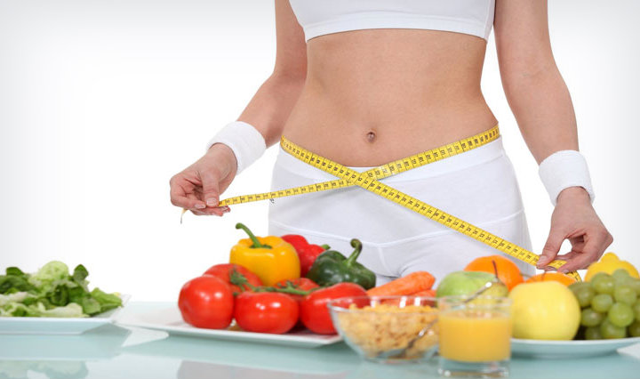
What is a good diet?
A healthy diet consists of eating a variety of foods that provide you with the nutrients you need to stay healthy, feel good and have energy. These nutrients include proteins, carbohydrates, fats, water, vitamins and minerals.

Slide 3
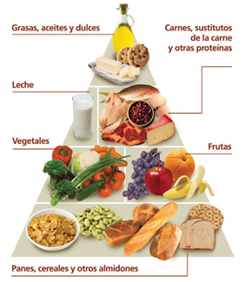
How does good food work?

Slide 4
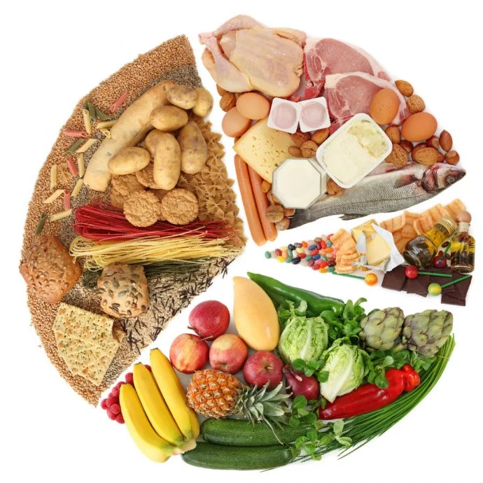
How to take a good diet!
fill half of the plate with vegetables and fruits fill a quarter of the plate with grains, half of them whole fill a quarter of the plate with lean proteins, without forgetting to vary the potreen sources and consume fish twice a week reduce the consumption of foods with a lot of sugar, salt and added fat

Slide 5
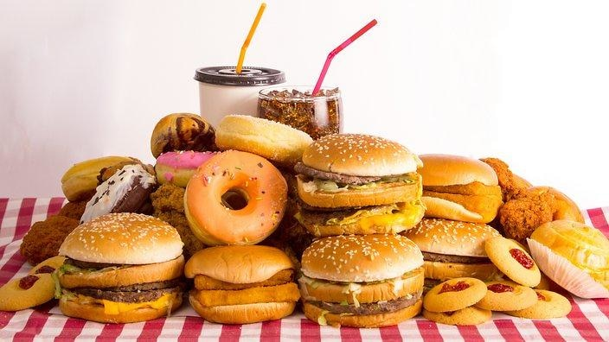
Consequences of a bad diet
Indigestion problems
.Diabetes
.High blood pressure
.Sleeping problems Design problems

Slide 6
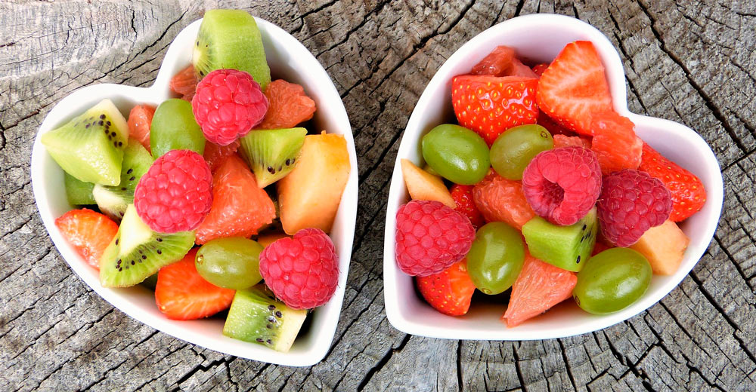
Conclusions Good nutrition is
lead a healthy life and with a good rhythm of food and with many food tastes without leaving behind the good handling of food
@

